Slide 1

T
CUAI 6기 CS231n 2팀 스터디
2022.05.16
발표자 : 이규원

Slide 2
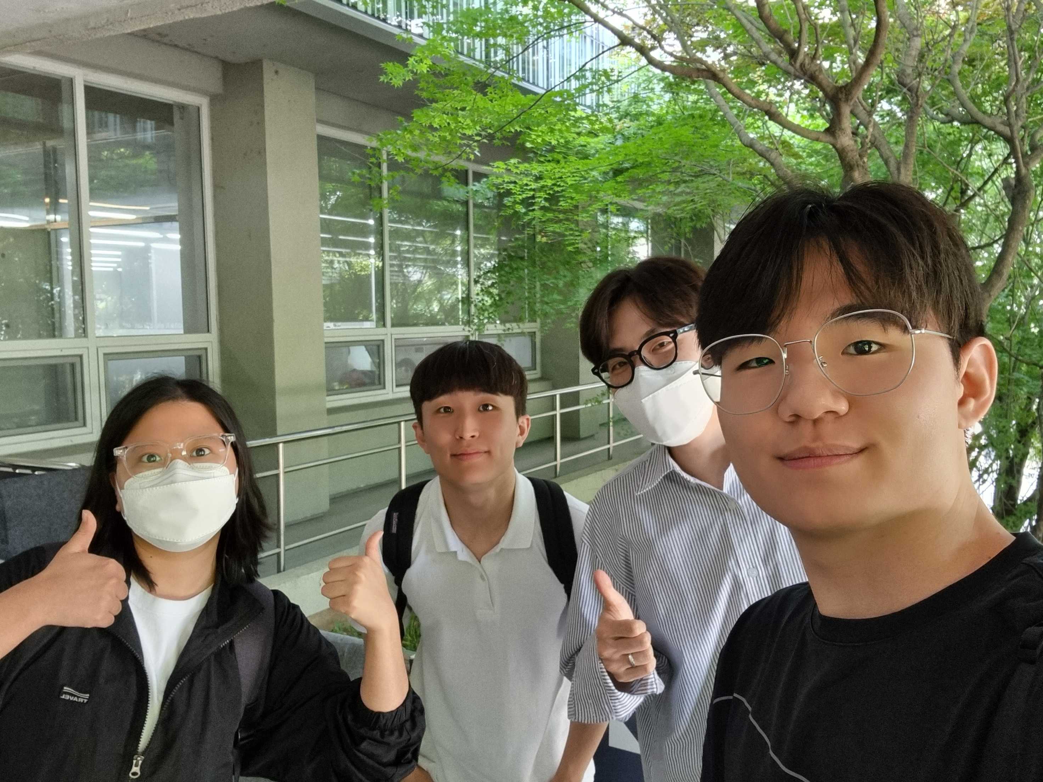
스터디원 소개 및 만남 인증
이곳에 만나서 찍은 사진을 넣어주세요.
(비대면일 경우엔 화면 캡쳐 이용)
얼굴이 나오게 찍어주셔야 합니다:D
곽수민(응용통계학과)
이규원(기계공학부)
정은진(수학과)
최동욱(소프트웨어학과)

Slide 3
목차
Semantic Segmentation
Classification + Localization
Object Detection
Instance Segmentation
SAM by META AI
Convolutional Layer 시각화
이미지 판단 중요 요소

Slide 4
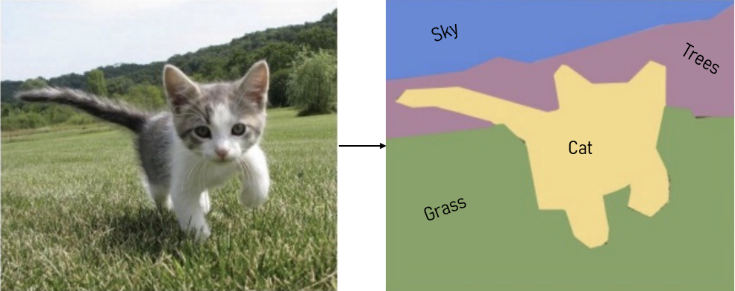
Semantic Segmentation

Slide 5
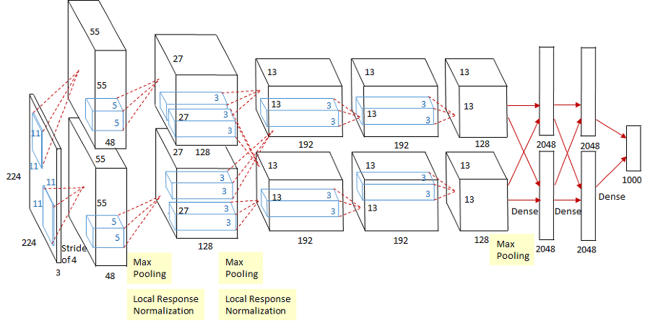
Semantic Segmentation
Cat
Grass
❓
Sliding Window ❌

Slide 6
Semantic Segmentation
C X H X W
(C = Class Score)
H
W
Sliding Window ❌
Fully Convolutional ❌

Slide 7
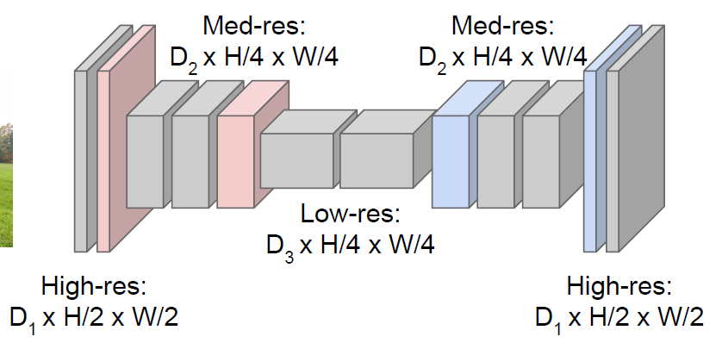
Semantic Segmentation
Sliding Window ❌
Fully Convolutional ❌
Fully Convolutional with Down-Sampling & Up-Sampling ⭕

Slide 8
Classification + Localization
Correct
Class
Class
Scores
(cat, dog, car, …)
Softmax
Loss
Multitask
Loss
Box
Coordinates
(x, y, w, h)
L2
Loss
Correct
Box

Slide 9
Object Detection

Slide 10
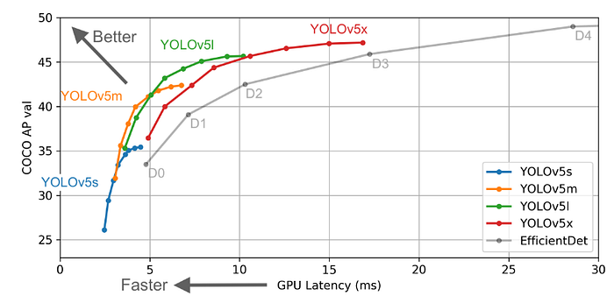
https://github.com/ultralytics/ultralytics
Object Detection – YOLO vs Faster R-CNN
YOLO(1-Stage)
👍
Faster R-CNN(2-Stage)

Slide 11
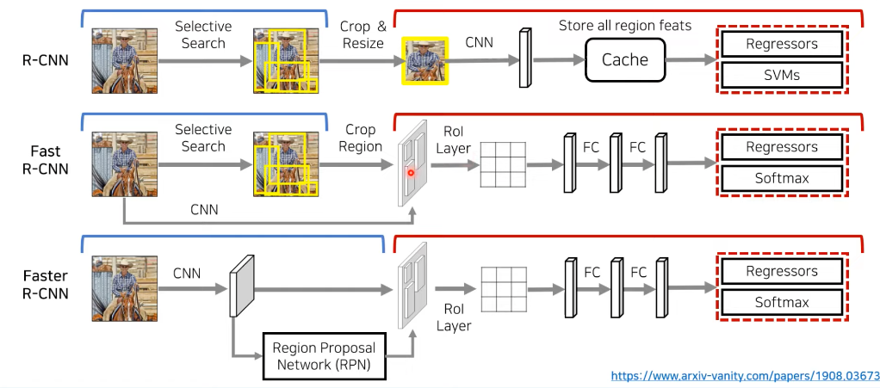
Object Detection – R-CNN (2 Stage)

Slide 12
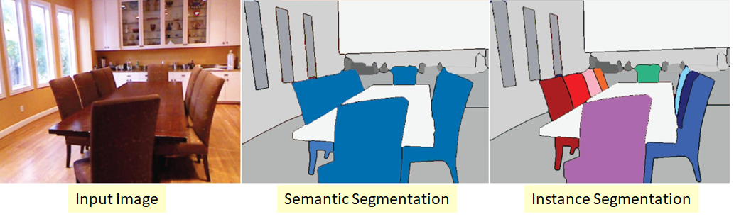
Instance Segmentation

Slide 13


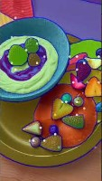
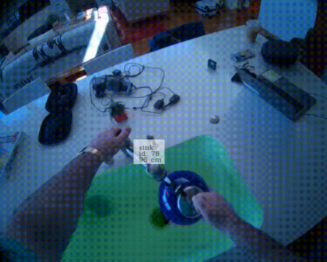
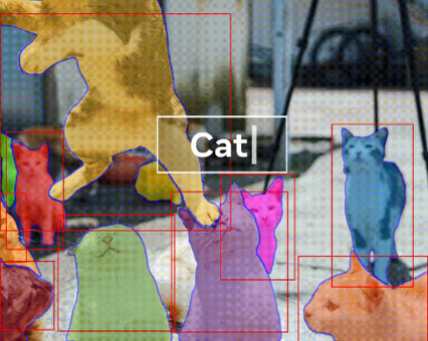
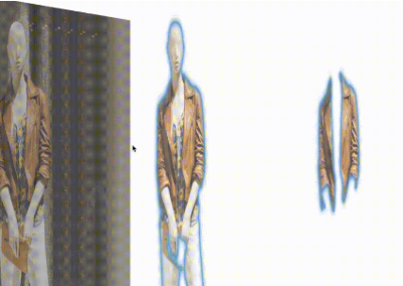
https://segment-anything.com/
+ SAM(Segment Anything Model) by Meta AI

Slide 14
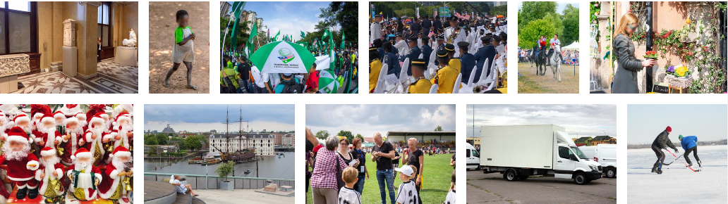

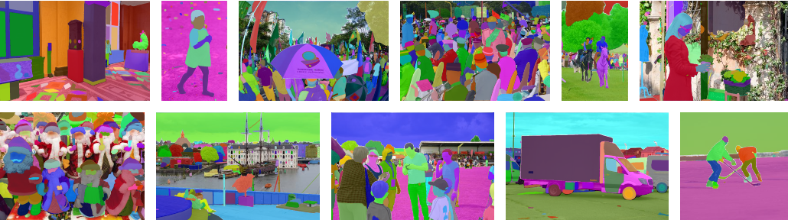
https://segment-anything.com/
+ SAM(Segment Anything Model) by

Slide 15
https://colab.research.google.com/drive/1IIjxurH2ai_te9Bvj4QU_MLcwgcLuEmC?hl=ko#scrollTo=vXkVg3tESboT
Convolutional Layer 시각화
Input
Filter
1
0
0
1
0
0
0
1
0
•
0
1
0
=
1X1 + 1X1 + 1X1 = 3
0
0
1
0
0
1
1
0
0
0
0
1
0
1
0
•
0
1
0
=
1X0 + 1X1 + 1X0 = 1
0
0
1
1
0
0
1
0
0
0
0
0
0
1
0
•
0
0
0
=
1X0 + 2X0 + 1X1 = 1
0
0
1
1
1
1

Slide 16
https://colab.research.google.com/drive/1IIjxurH2ai_te9Bvj4QU_MLcwgcLuEmC?hl=ko#scrollTo=vXkVg3tESboT
Convolutional Layer 시각화
Input
Filter
1
0
0
1
0
0
0
1
0
•
0
1
0
=
1X1 + 1X1 + 1X1 = 3
0
0
1
0
0
1
1
0
0
0
0
1
0
1
0
•
0
1
0
=
1X0 + 1X1 + 1X0 = 1
0
0
1
1
0
0
1
0
0
0
0
0
0
1
0
•
0
0
0
=
1X0 + 2X0 + 1X1 = 1
0
0
1
1
1
1

Slide 17
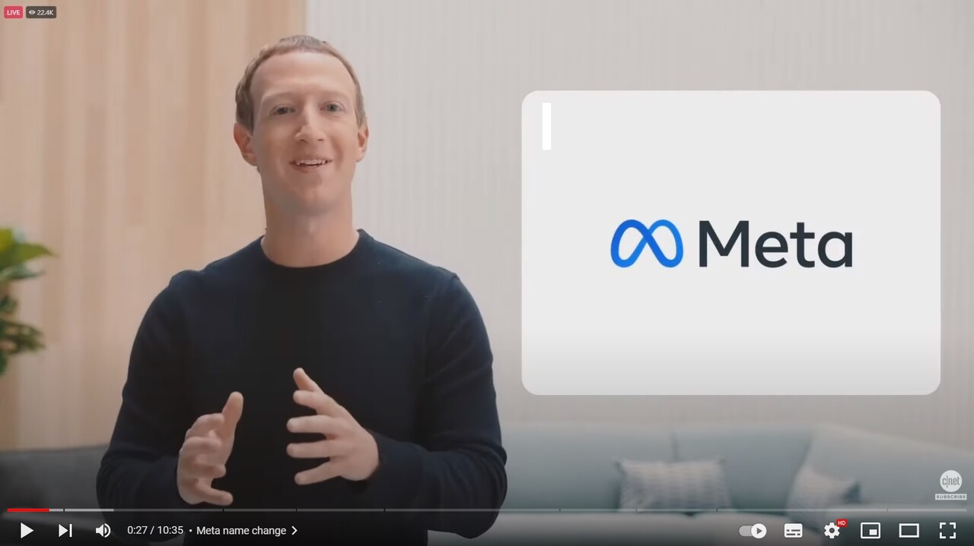
https://colab.research.google.com/drive/1IIjxurH2ai_te9Bvj4QU_MLcwgcLuEmC?hl=ko#scrollTo=vXkVg3tESboT
Convolutional Layer 시각화

Slide 18
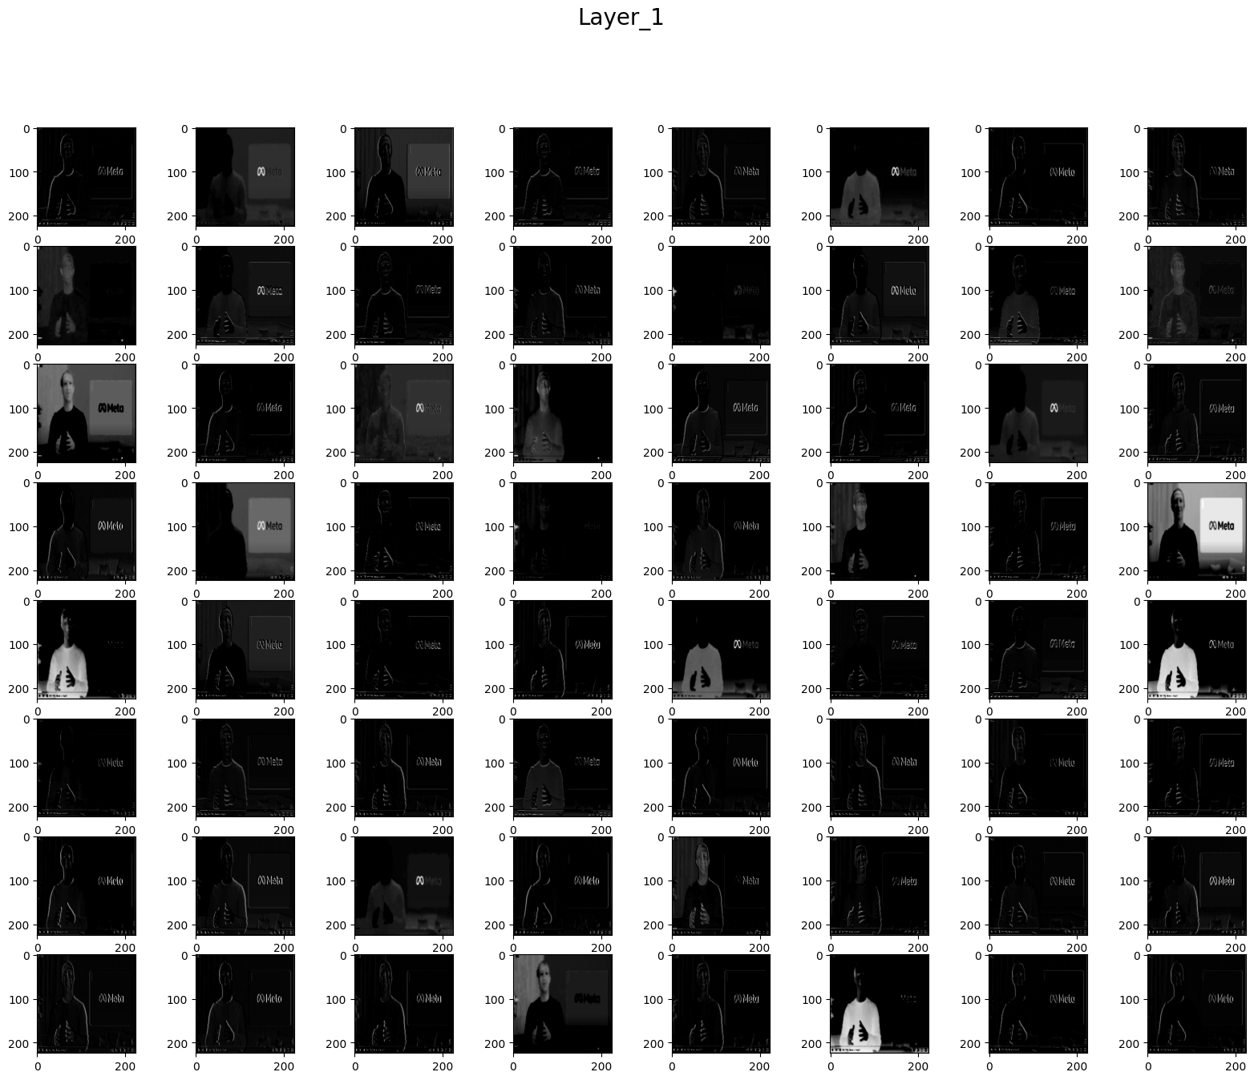
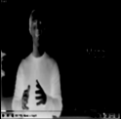

https://colab.research.google.com/drive/1IIjxurH2ai_te9Bvj4QU_MLcwgcLuEmC?hl=ko#scrollTo=vXkVg3tESboT
Convolutional Layer 시각화

Slide 19
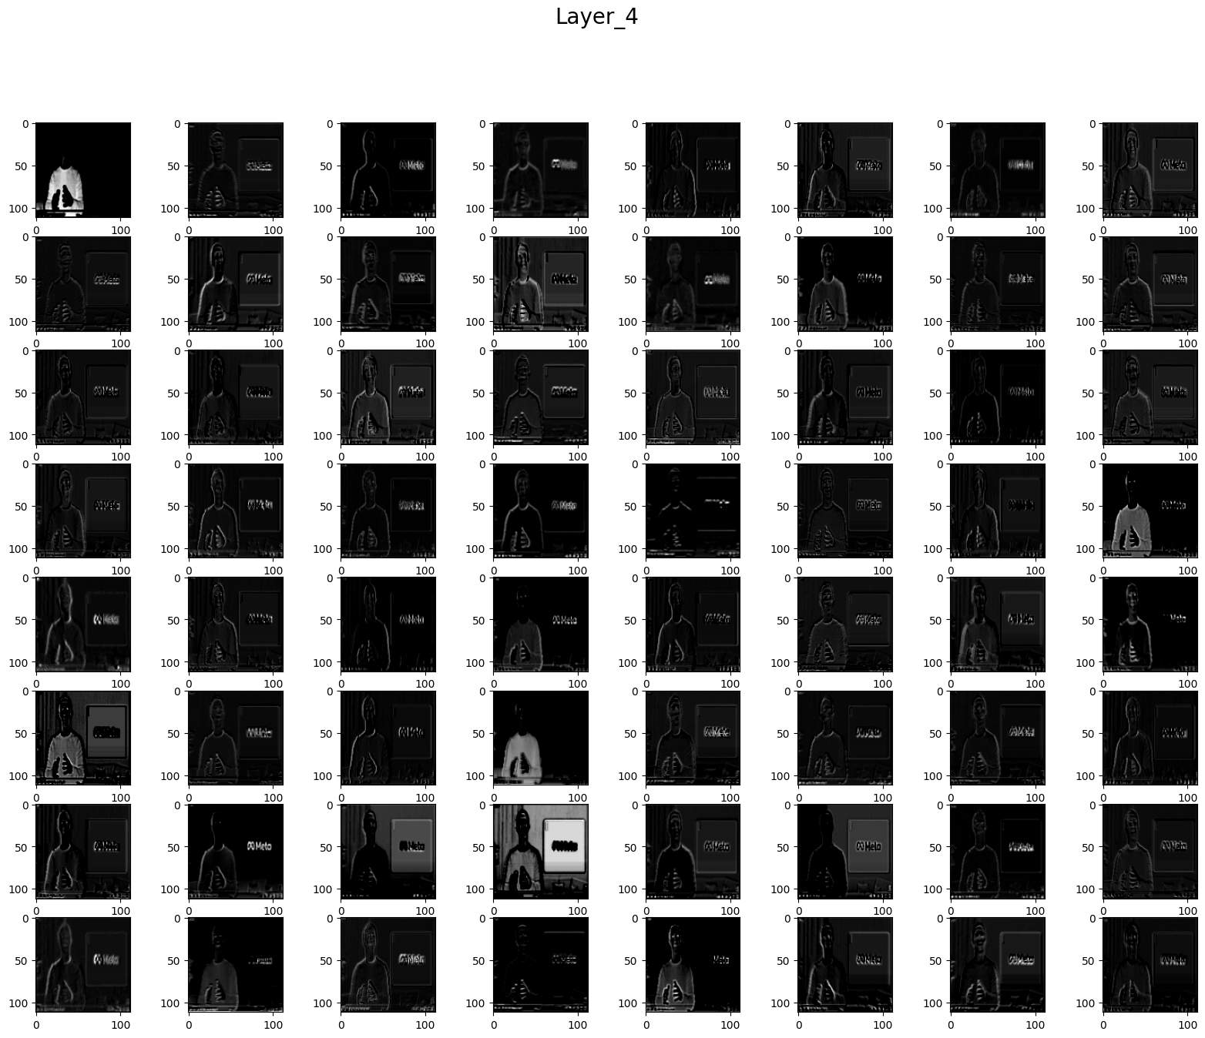
https://colab.research.google.com/drive/1IIjxurH2ai_te9Bvj4QU_MLcwgcLuEmC?hl=ko#scrollTo=vXkVg3tESboT
Convolutional Layer 시각화

Slide 20
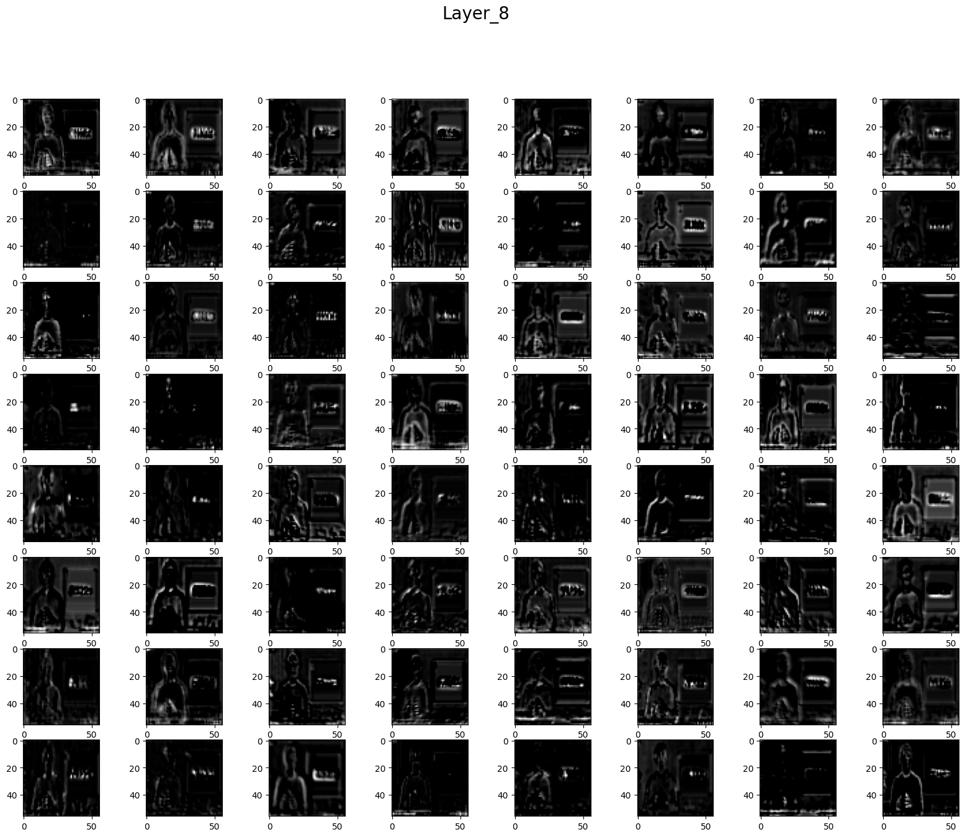
https://colab.research.google.com/drive/1IIjxurH2ai_te9Bvj4QU_MLcwgcLuEmC?hl=ko#scrollTo=vXkVg3tESboT
Convolutional Layer 시각화

Slide 21
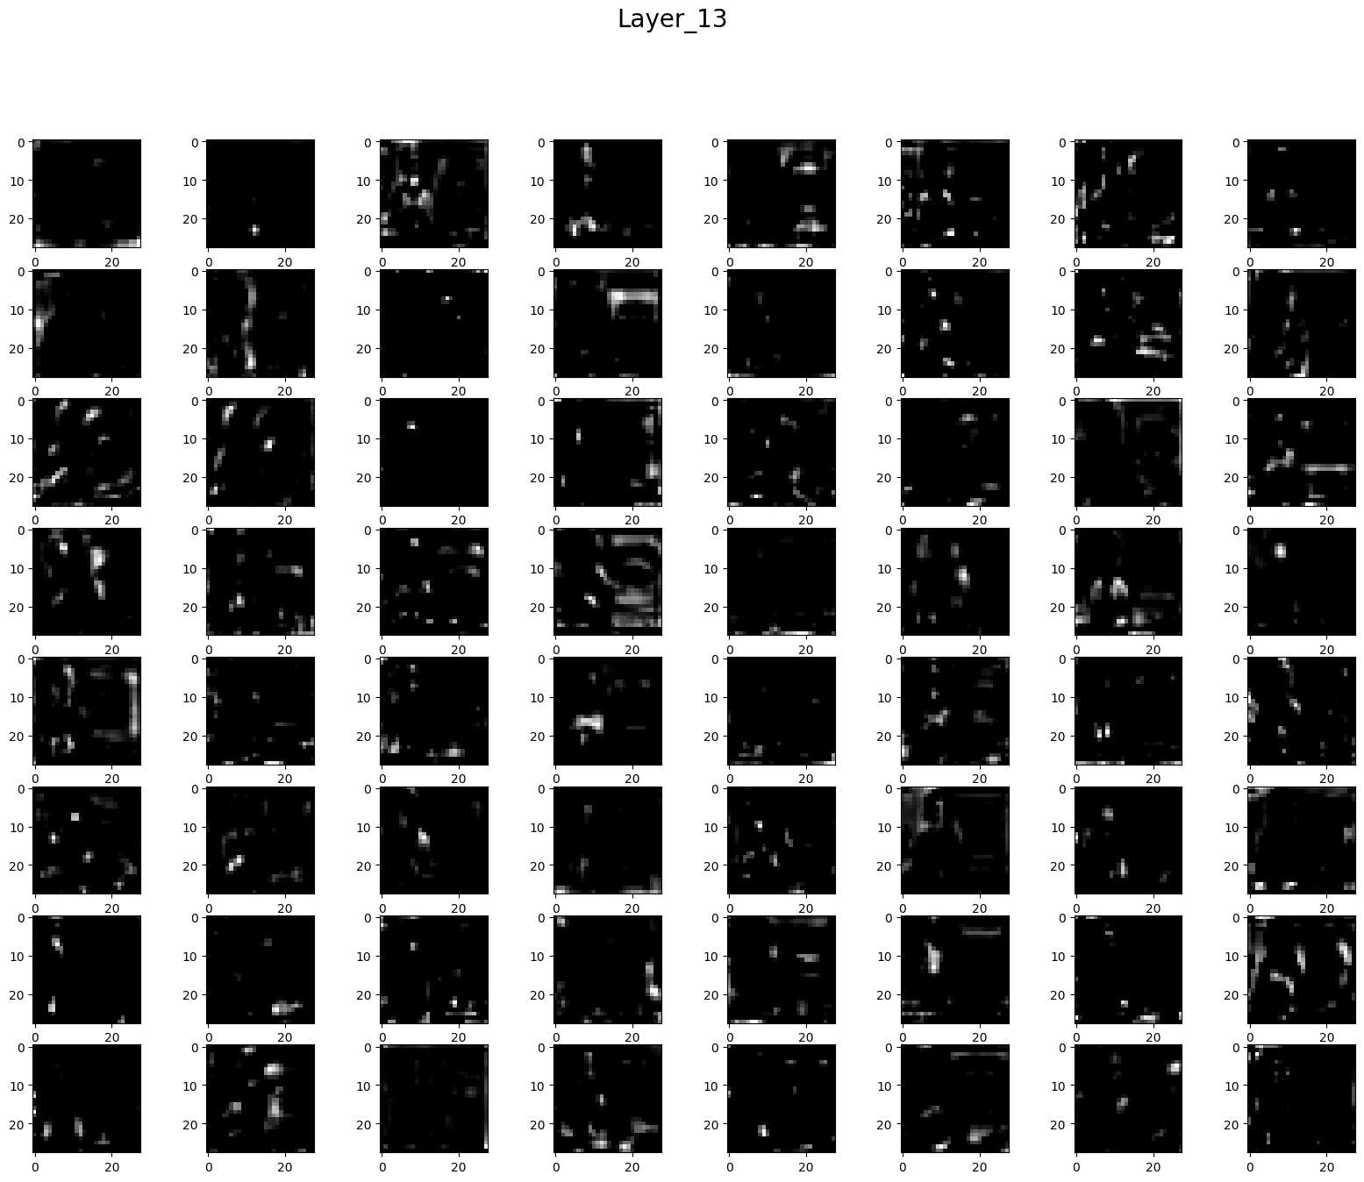
https://colab.research.google.com/drive/1IIjxurH2ai_te9Bvj4QU_MLcwgcLuEmC?hl=ko#scrollTo=vXkVg3tESboT
Convolutional Layer 시각화

Slide 22
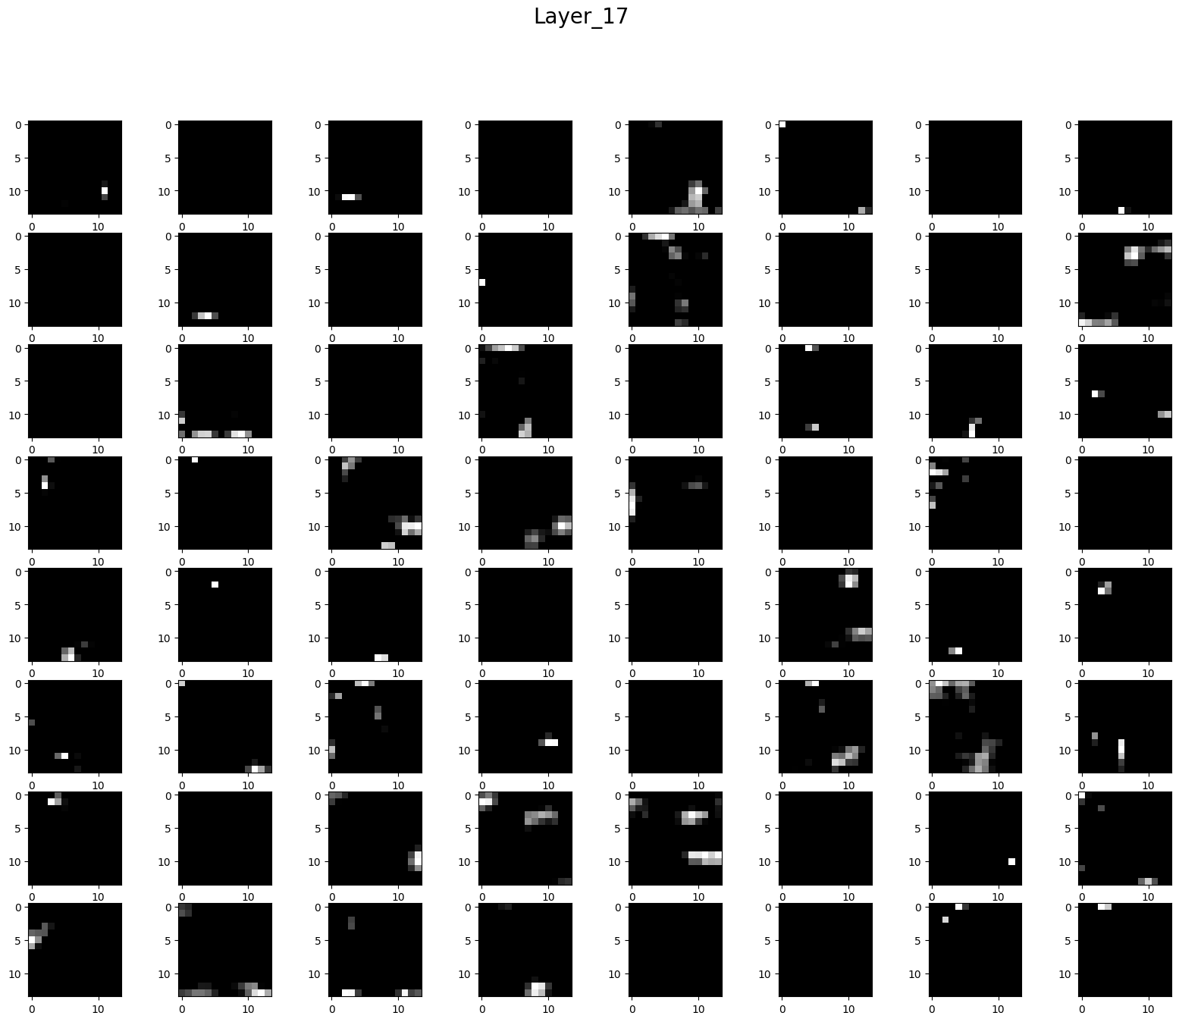
https://colab.research.google.com/drive/1IIjxurH2ai_te9Bvj4QU_MLcwgcLuEmC?hl=ko#scrollTo=vXkVg3tESboT
Convolutional Layer 시각화

Slide 23
https://colab.research.google.com/drive/1IIjxurH2ai_te9Bvj4QU_MLcwgcLuEmC?hl=ko#scrollTo=vXkVg3tESboT
Convolutional Layer 시각화
Layer 1
Layer 4
Layer 8
Layer 13
Layer 17

Slide 24
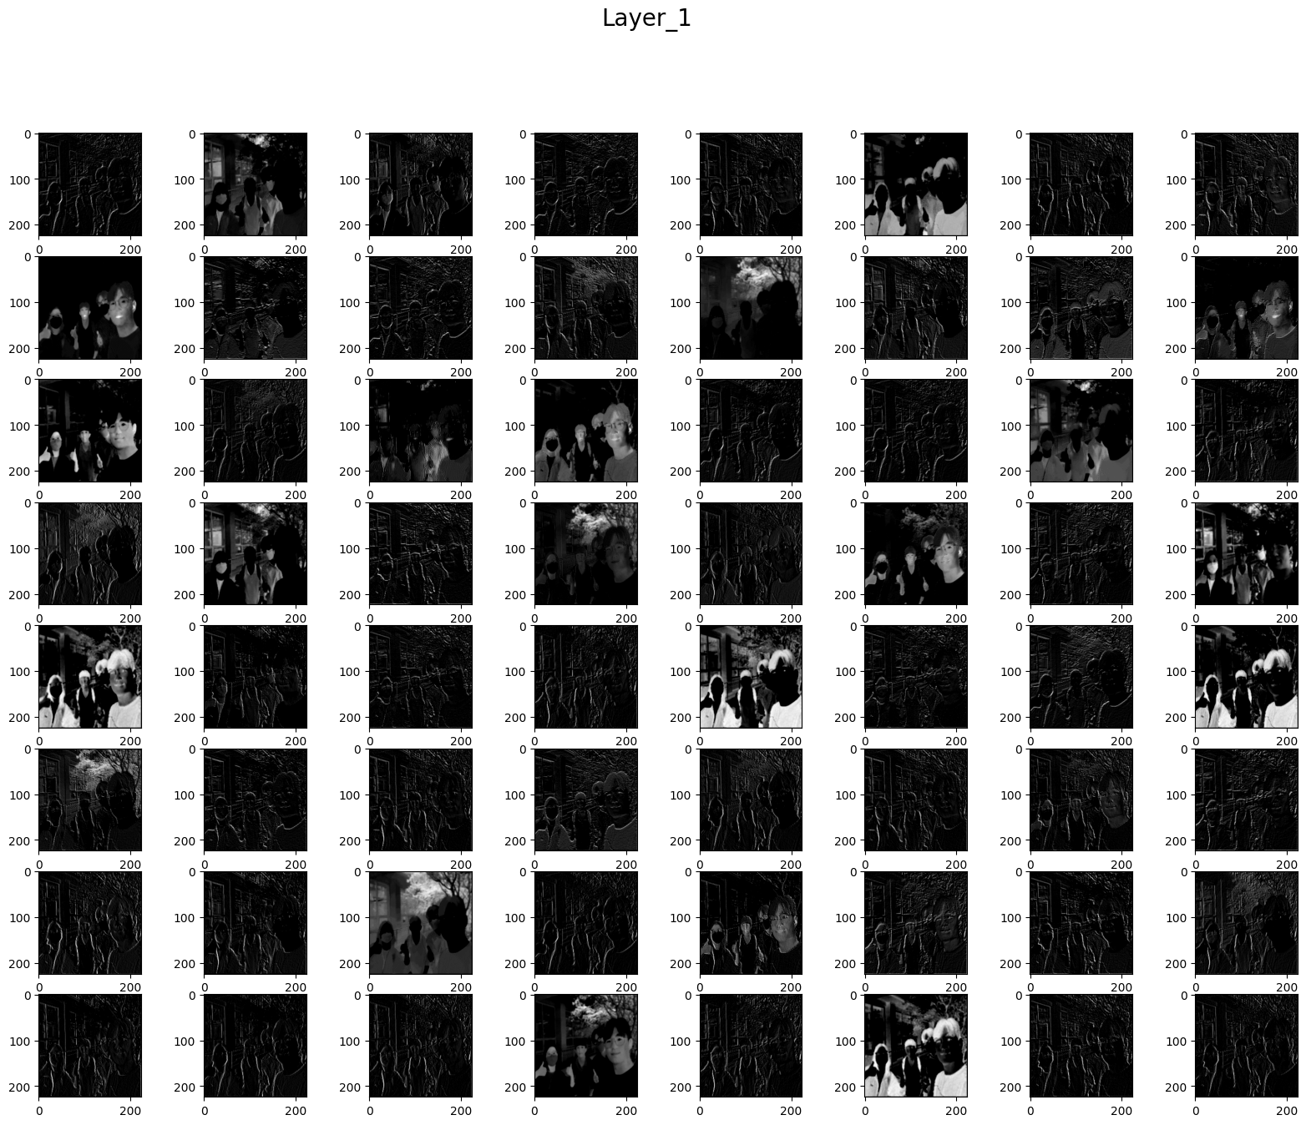
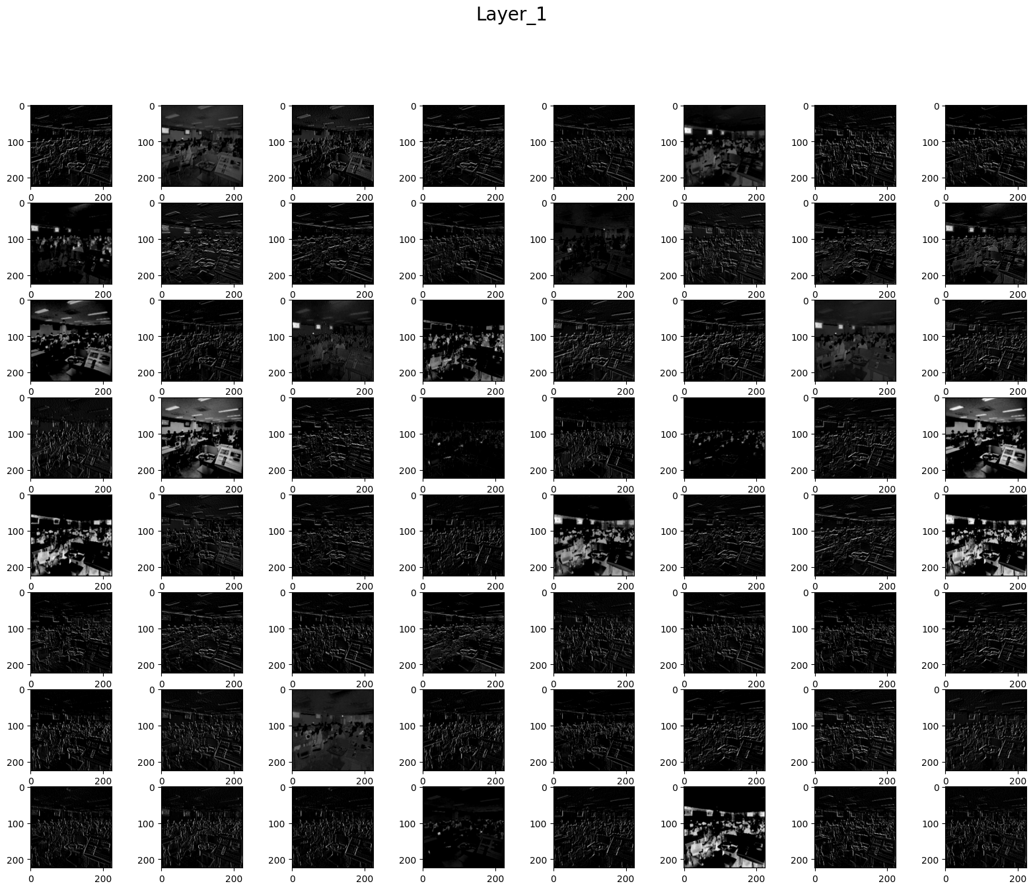
https://colab.research.google.com/drive/1IIjxurH2ai_te9Bvj4QU_MLcwgcLuEmC?hl=ko#scrollTo=vXkVg3tESboT
Convolutional Layer 시각화
05/11 스터디 인증 사진
05/09 세션 단체 사진

Slide 25
Convolutional Layer 시각화

Slide 26
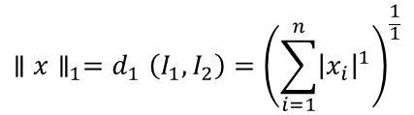
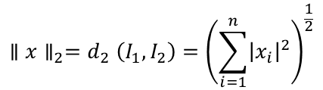
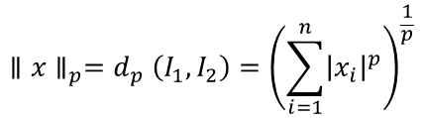
Convolutional Layer 시각화
Input
L2 Nearest Neighbors in Feature Space
LP Norm
$${∥x∥_{p}=d}_{p}\left(I_{1}, I_{2}\right)={\left(\sum_{i=1}^{n}{{\left|x_{i}\right|}^{p}}\right)}^{\frac{1}{p}}$$
L1 Norm
$${∥x∥_{1}=d}_{1}\left(I_{1}, I_{2}\right)={\left(\sum_{i=1}^{n}{{\left|x_{i}\right|}^{1}}\right)}^{\frac{1}{1}}$$
L2 Norm
$${∥x∥_{2}=d}_{2}\left(I_{1}, I_{2}\right)={\left(\sum_{i=1}^{n}{{\left|x_{i}\right|}^{2}}\right)}^{\frac{1}{2}}$$

Slide 27
이미지 판단 중요 요소

Slide 28
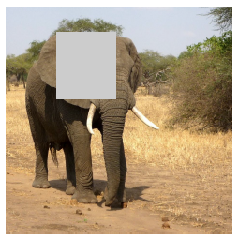
이미지 판단 중요 요소

Slide 29
이미지 판단 중요 요소

